Slide 1
Please Follow this steps to watch
the First Aid (Video) Training Guide
★If you don’t watch and take this videos,
you will get an F on Personality Seminar class.★
Steps: homepage Login → Cyber Campus → 2018 First Aid Training
If you have questions, ask to your personality seminar’s advisor.

Slide 2

1. Please login

Slide 3
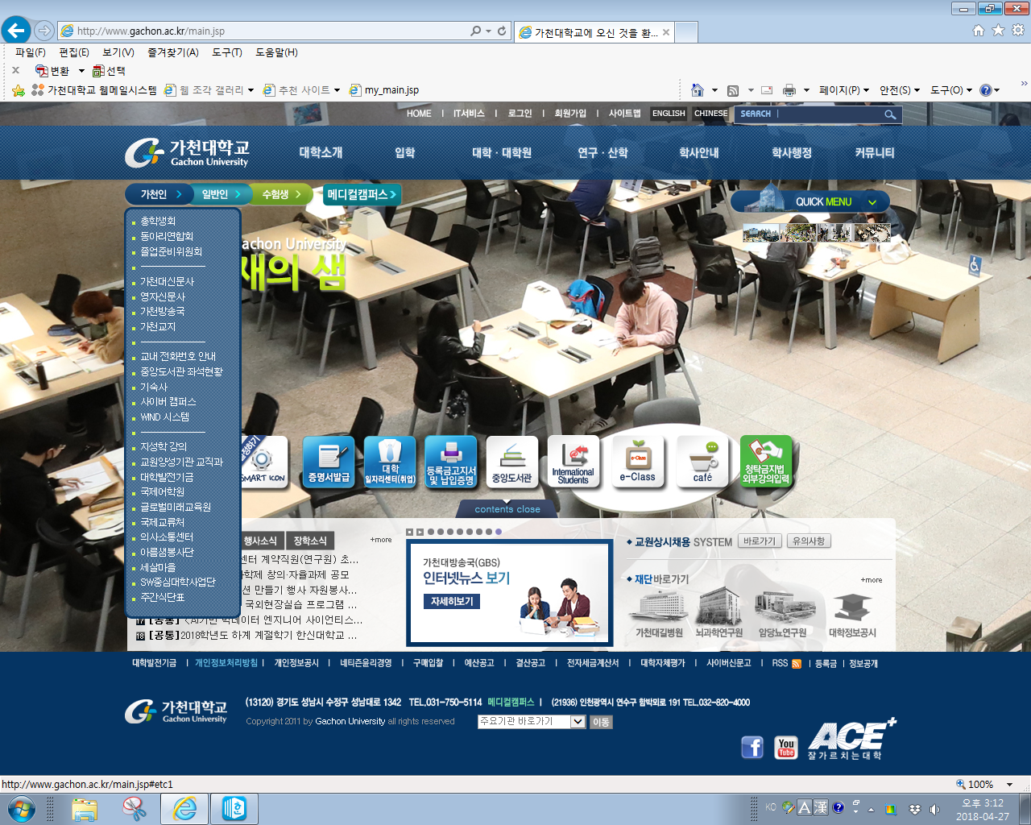
2. Click here

Slide 4
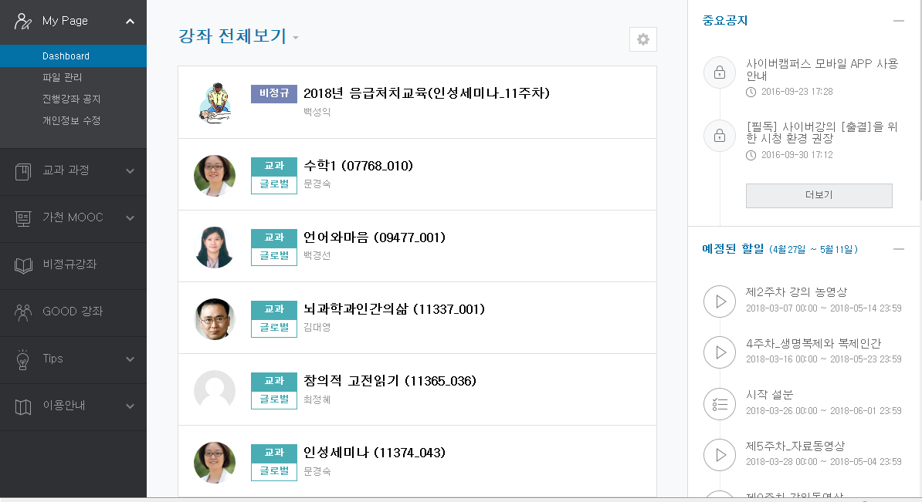
First Aid (Video) Training Guide
3. Click here

Slide 5
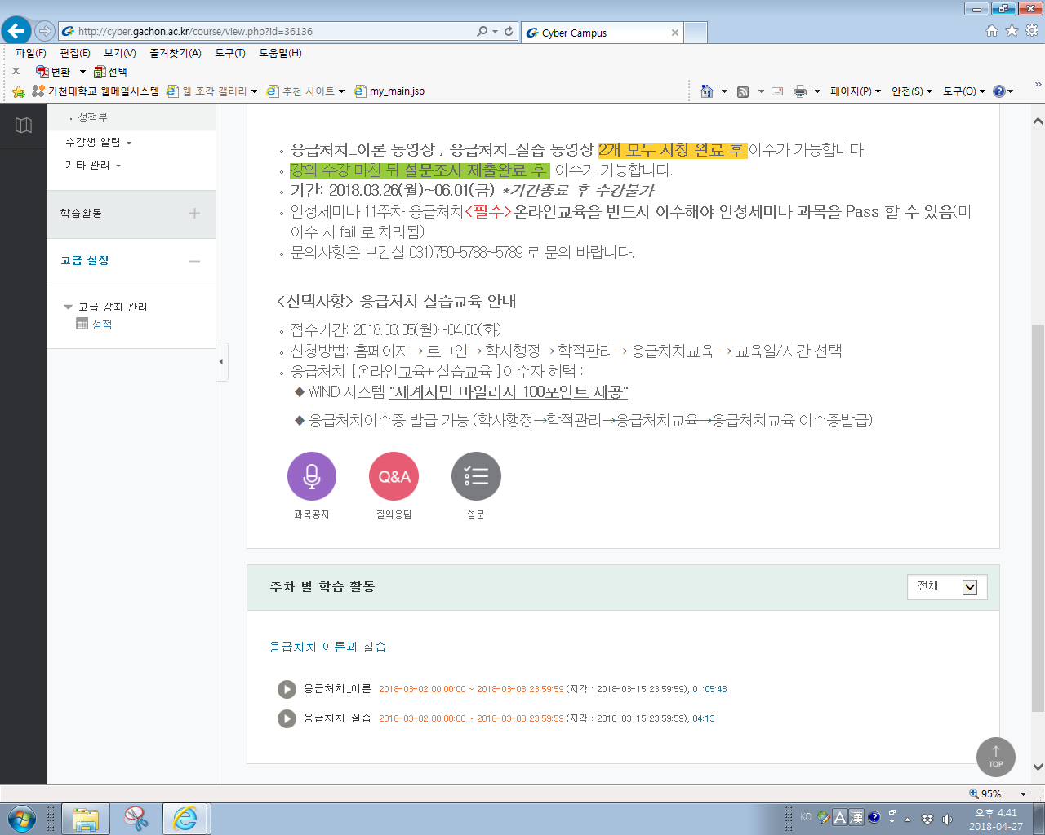
Watch these two videos
You must watch both. If you don’t, you will get an F.

Slide 6
Thanks!

